Slide 1
Algorithm & Data Structure II
Hello “Trees”
Dr Jing Wang
jing.wang@shu.ac.uk
Cantor 9339

Slide 2

Examples
A Tree Examples – Coffee-Shop Names
https://informationisbeautiful.net/visualizations/a-taxonomy-of-hipster-coffee-shop-names/
A Graph Example – A Dogs Map
http://christianspreafico.altervista.org/Dogs/indexDogs.php
Also…Think about two questions:
Trees vs. vectors/linked list/hash maps/queues/stacks
What do you need in order to build a tree structure?

Slide 3
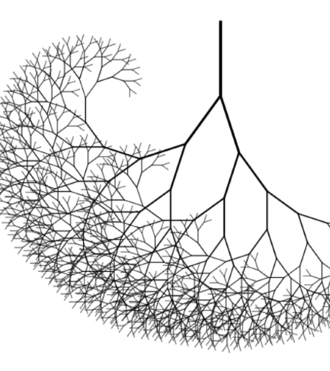
Tree
A way of representing the hierarchical nature of a structure in a graphical form
A non-linear data structure

Slide 4
Tree Terminology
A
Parent
Root
Child
B
C
Leaf
Siblings
D
E
F
G
H
Ancestor
Descendant
I
J
K
L
O
M
N
P
https://goo.gl/forms/TVV0WVK4tsivBIGJ2

Slide 5
Tree Terminology A tree is a collection of entities called nodes. Nodes are connected by edges. Each node contains a value or data.
Parent: The predecessor of a node
Child: Any successor of a node
Siblings: Any pair of nodes that have the same parent
Ancestor: The predecessor of a node together with all the ancestors of the predecessor of a node
Descendant: The children of a node together with all the descendants of the children of a node
Root: This is the start of the data structure. The unique node with no predecessor is called the root of the tree
Leaf: A node with no successors

Slide 6
Tree Terminology
Depth of a node The length of the path from the root to the node
Height of a node The length of the path from the node to its deepest node
Height of a tree The length of the path from the root to its deepest node
The level of a node is defined with respect to the number of its ancestors:
The root is defined as being at level 0
The children of the root are at level 1
The children of a node at level i are at level i+1

Slide 7
Sub-tree
A
B
C
D
E
F
G
H
I
J
K
L
O
M
N
P

Slide 8
Sub-tree
A
Sub-tree
Another sub-tree

Slide 9
Sub-tree
A
B
C
D
E
F
G
H
I
J
K
L
O
M
N
P

Slide 10
Sub-tree
A
B
C
F
G
H
O
M
N
P

Slide 11
Sub-tree
A
B
C
D
E
F
G
H
I
J
K
L
O
M
N
P

Slide 12
Sub-tree
A
B
C
D
E
F
G
H
J
K
L
O
M
N
P

Slide 13
Sub-tree
A
B
C
D
E
F
G
H
I
J
K
L
O
M
N
P

Slide 14
Sub-tree
A
B
C
D
E
F
G
H
I
J
K
L
O
M
N
P

Slide 15
Recursive Definition
A tree is a finite set of one or more nodes
One of those nodes is designate to be the root
The remaining nodes are partitioned in n ≥ 0 disjoint sets T₁, T₂, ..., T_{n} where each is a subtree of the root
The sets T₁, T₂, ..., T_{n} are themselves trees with a root and subtrees
Subtrees are never connected together (T₁, T₂, ..., T_{n} are disjoint)

Slide 16
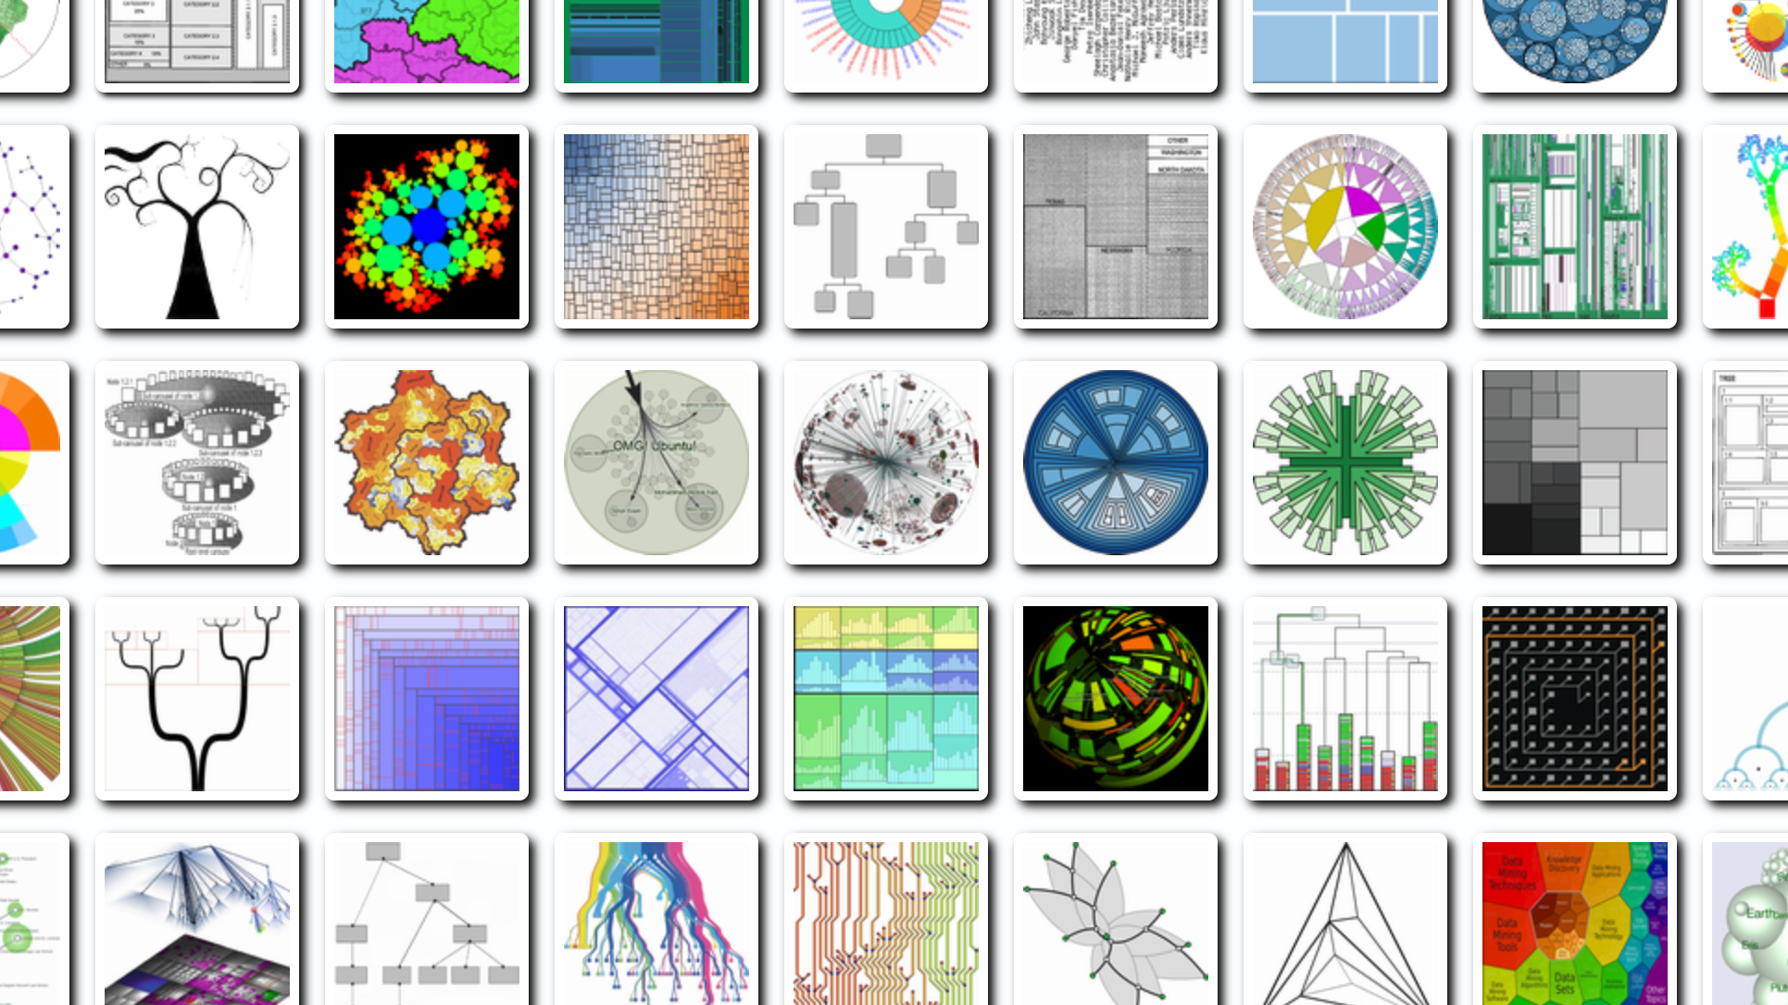
Representations
It is a very popular data visualisation research topic
Useful resource
Treevis.net
http://www.randelshofer.ch/treeviz/

Slide 17
Implementation – Tree Node
Modified Linked List:
Each node needs a varying number of next item references
Number of node references could be fixed or dynamic
Left Child - Right Sibling Representation
Use Doubly Linked List to get its parent
DATA
Ref 1
Ref 2
Ref …
Ref n
My left child
DATA
My right sibling

Slide 18
Task
Create a linked list-based tree node structure
The node can have at least two children
Bonus: The number of children can be fixed or dynamic
Add an parent reference
Think about time and space efficiency
Create a addChild() method in the tree class and manually add tree nodes from the main java class. Create a tree using the example on the right.
Organism
Animal
Plant
Vertebrate
Flower
Tree
Mammal
Bird
Evergreen
Human
Mouse
Cat
Robin

